Slide 1

CMR TECHNICAL CAMPUS Accredited by NBA, Approved by AICTE, affiliated to JNTUH Kandlakoya (V), Medchal Road, Hyderabad -501401
DEPARTMENT OF COMPUTER SCIENCE AND ENGINEERING
Image Based Classification Of Malware Using Deep Learning
Under the guidance :
A. Kiran Kumar
GROUP MEMBERS :
Mohammed Abdul Haseeb (187R1A05G4)
Gardas Nithin Kumar (187R1A05E5)
Ersetpally Anudeep Goud (187R1A05E2)

Slide 2
CONTENTS
Abstract
Existing System
Disadvantages of Existing System
Proposed System
Advantages of Proposed System
Hardware Requirements
Software Requirements
Project Architecture
Modules Description
UML Diagrams
Sample Code
Result
Conclusion
Future Enhancement

Slide 3
ABSTRACT
The number of malicious files detected every year are counted by millions. One of the main reasons for these high volumes of different files is the fact that, in order to evade detection, malware authors add mutation. This means that malicious files belonging to the same family, with the same malicious behavior, are constantly modified or obfuscated using several techniques, in such a way that they look like different files. In order to be effective in analyzing and classifying such large amounts of files, we need to be able to categorize them into groups and identify their respective families on the basis of their behavior. In this project, malicious software is visualized as images since its ability to capture minor changes while retaining the global structure helps to detect variations.

Slide 4
EXISTING SYSTEM
One of the major challenges in the realm of security threats is malicious software which is also referred as malware. The main focus of malware is, to gather the personal information without the attention of users and to disturb the computer operations which makes problems for users.
There are many kinds of malware i.e., Virus, Worm, Trojan-horse, Rootkit, Backdoor, Spyware, Adware etc. Annual reports from antivirus companies show that thousands of new malwares are created every single day.
These new malwares become more sophisticated that they could no longer be detected by the traditional detection techniques such as signature-based detection, heuristic detection or behavior-based detection. Signature-based detection searches for specified bytes sequences into an object so that it can identify exceptionally a particular type of a malware.

Slide 5
DISADVANTAGES
Its drawback is that it cannot detect zero-day or new malware since these malware signatures are not supposed to be listed into the signature database.
Some part of the process has to be done manually.
The computational complexity of malware is not clear, and the detection of malware problem is proved to be NP-complete.

Slide 6
PROPOSED SYSTEM
In the proposed model uses CNN with machine learning algorithms as an intelligent system that classifies malware images efficiently to the respective classes.
The “malimg-dataset9010" dataset is divided into two parts one for training CNN module and another for validating it.
The dataset contains 8404 samples of 25 malware families.

Slide 7
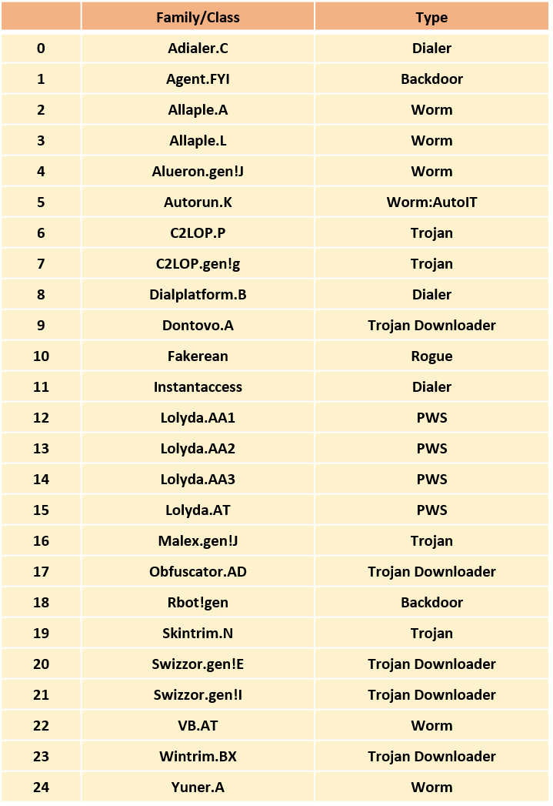
Dataset Overview

Slide 8
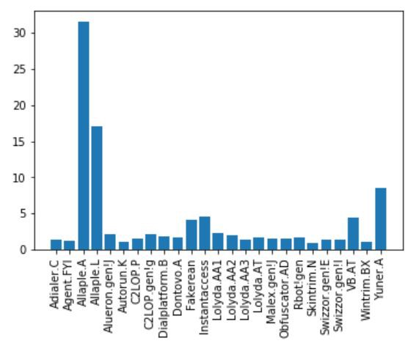
Dataset Overview

Slide 9
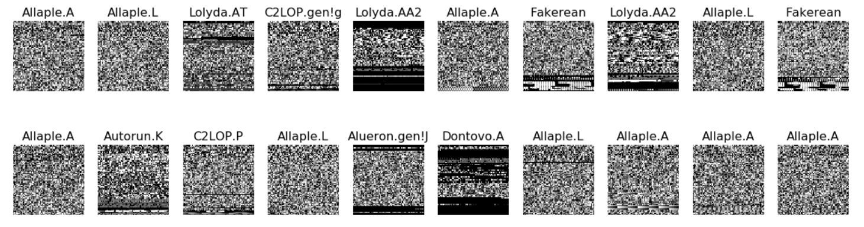
Sample Dataset

Slide 10
Binary to Image
A given malware binary file is first read in a vector of 8-bits unsigned integers.
The binary value of each component of this vector is converted to its equivalent decimal value.
[00000000] [0] Black
[11111111] [255] White
At last, the resulting decimal vector is reshaped to a 2D matrix and visualized as a grayscale image.

Slide 11
ADVANTAGES
It is much faster than existing system.
Effective to detect different variants of the same malware.
Effective to detect new malware.

Slide 12
HARDWARE REQUIREMENTS
For developing the application, the following are the Hardware Requirements:
System : Intel i5
Hard Disk : 4 GB
Input : malimg-dataset9010
Ram : 2 GB

Slide 13
SOFTWARE REQUIREMENTS
For developing the application, the following are the Software Requirements:
Operating system : Windows 7,8,10
Coding Language : Python 3.7 with Sklearn, numpy, seaborn & keras.
Tool : Google Collaboratory Notebook
Database : Hard disk

Slide 14
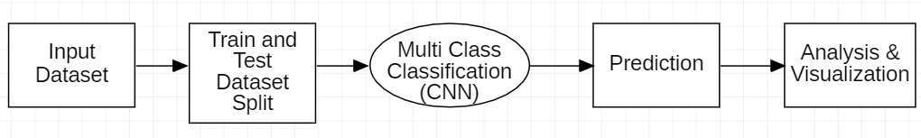
PROJECT ARCHITECTURE

Slide 15
PROJECT ARCHITECTURE
Convolutional Layer : 30 filters, (3 * 3) kernel size
Max Pooling Layer : (2 * 2) pool size
Convolutional Layer : 15 filters, (3 * 3) kernel size
Max Pooling Layer : (2 * 2) pool size
DropOut Layer : Dropping 25% of neurons.
Flatten Layer
Dense/Fully Connected Layer : 128 neurons, Relu activation function
DropOut Layer : Dropping 50% of neurons.
Dense/Fully Connected Layer : 50 neurons, Softmax activation function
Dense/Fully Connected Layer : num_class neurons, Softmax activation function

Slide 16
MODULES DESCRIPTION
Module 1: Pre-processing Dataset
Module 2: Train the Model
Module 3: Analysis

Slide 17
MODULE 1: Pre-processing Dataset
Unzip the dataset : Unzipping is the act of extracting the files from a zipped single file or similar file archive. If the files in the package were also compressed (as they usually are), unzipping decompresses them.
Data augmentation : Data augmentation is the process of modifying, or “augmenting” a dataset with additional data. This additional data can be anything from images to text, and its use in machine learning algorithms helps improve their performance.

Slide 18
MODULE 2: Train the Model
Train/Test split : The train-test split is used to estimate the performance of machine learning algorithms that are applicable for prediction-based Algorithms.
Balance class weight : Data are said to suffer the Class Imbalance Problem when the class distributions are highly imbalanced which leads to low predictive accuracy for the infrequent class.
Compile and train model : Compile defines the loss function, the optimizer and the metrics. You need a compiled model to train (because training uses the loss function and the optimizer).

Slide 19
MODULE 3: Analysis
Finding Accuracy : It is the measurement used to determine which model is best at identifying relationships and patterns between variables in a dataset based on the input, or training, data.
Plotting Confusion matrix : A Confusion matrix is an N x N matrix used for evaluating the performance of a classification model, where N is the number of target classes. The matrix compares the actual target values with those predicted by the machine learning model.

Slide 20
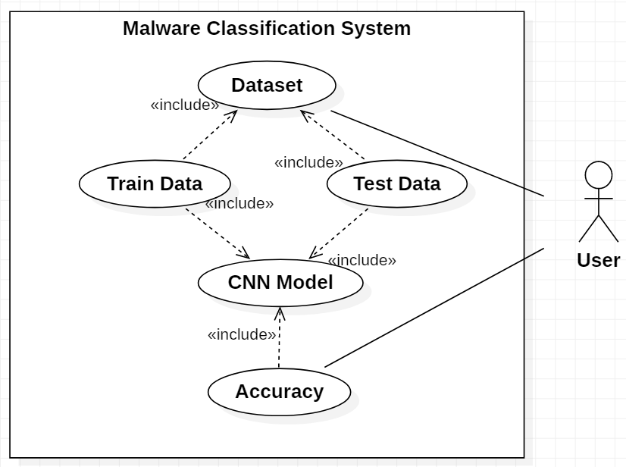
USE CASE DIAGRAM

Slide 21
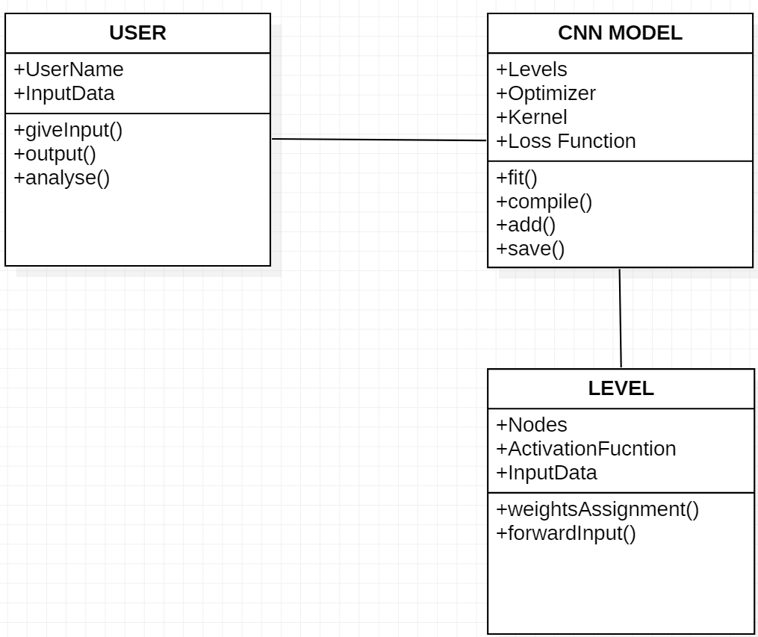
CLASS DIAGRAM

Slide 22
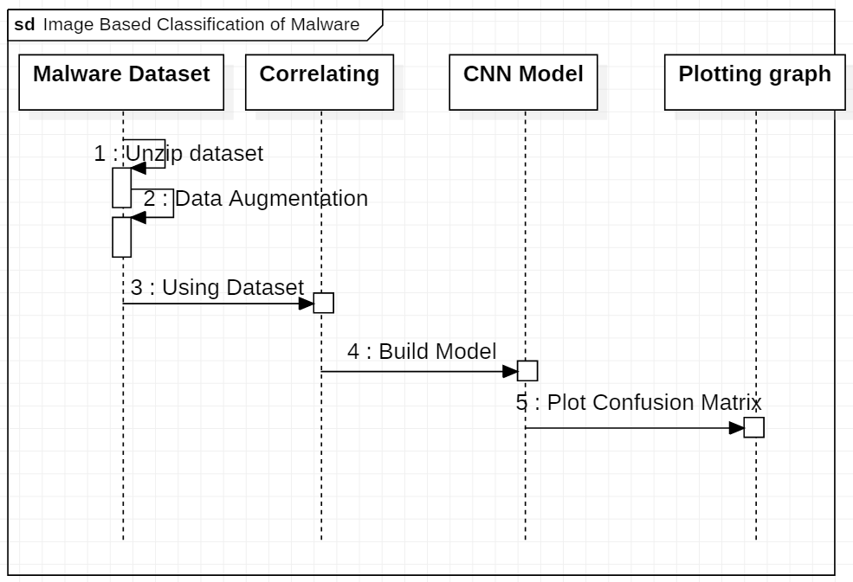
SEQUENCE DIAGRAM

Slide 23
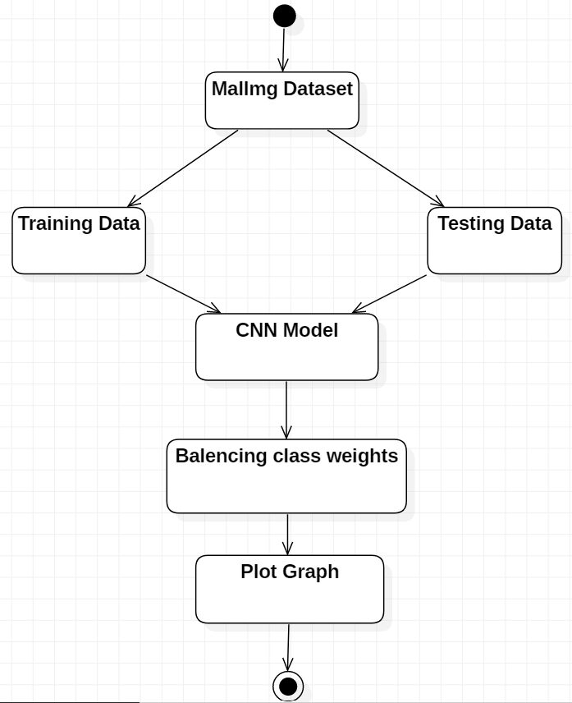
ACTIVITY DIAGRAM

Slide 24
SAMPLE CODE
#unzipping the dataset
!unzip malimg-dataset9010.zip
#splitting test and train dataset
from sklearn.model_selection import train_test_split
X_train, X_test, y_train, y_test = train_test_split(imgs/255.,labels, test_size=0.3)

Slide 25
#designing classification model
def malware_model():
Malware_model = Sequential()
Malware_model.add(Conv2D(30, kernel_size=(3, 3),
activation='relu',
input_shape=(64,64,3)))
Malware_model.add(MaxPooling2D(pool_size=(2, 2)))
Malware_model.add(Conv2D(15, (3, 3), activation='relu'))
Malware_model.add(MaxPooling2D(pool_size=(2, 2)))
Malware_model.add(Dropout(0.25))
Malware_model.add(Flatten())
Malware_model.add(Dense(128, activation='relu'))
Malware_model.add(Dropout(0.5))
Malware_model.add(Dense(50, activation='relu'))
Malware_model.add(Dense(num_classes, activation='softmax'))
Malware_model.compile(loss='categorical_crossentropy', optimizer = 'adam', metrics=['accuracy'])
return Malware_model

Slide 26
#balancing the dataset distribution of classes
class_weights = class_weight.compute_class_weight(class_weight='balanced',
classes = np.unique(y_train_new),
y = y_train_new)
class_weight_dict = dict(enumerate(class_weights))
#training the model against train dataset
Malware_model.fit(X_train, y_train, validation_data=(X_test, y_test), epochs=20,
class_weight=class_weight_dict)
#plotting confusion matrix
c_matrix = metrics.confusion_matrix(y_test2, y_pred)

Slide 27
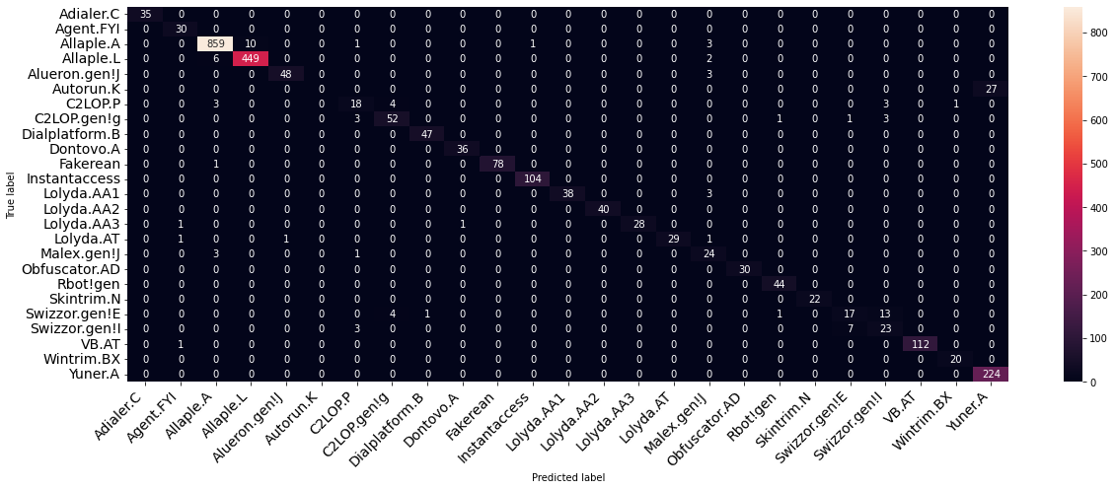
RESULT

Slide 28
CONCLUSION
Malware is most commonly used for performing attacks by cyber attackers. To control the attackers from performing attacks, stealing the information, and harming computer systems, security specialists and antimalware software companies are constantly working on identifying new methods.
The proposed model achieves more accurate results with minimal rate of misclassification in less time and computational resources.

Slide 29
FUTURE ENHANCEMENT
In future we can use other type of convolutional neural networks by downloading the modules directly into the project files. The proposed system is much faster and efficient to identify the malware. Hence it can be used in antivirus software to determine malicious files. This model can combinedly used with other models to detect malware. This model can grow if we can combine other datasets.

Slide 30
Thank you

